Slide 2
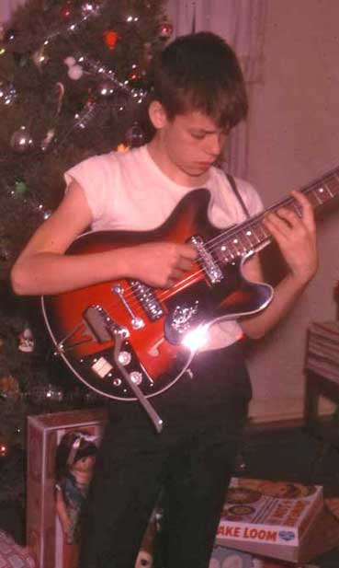
1

Slide 3

2

Slide 4

The Indescribable Gift
“Thanks be to God for His indescribable gift.” (2 Cor. 9:15)
3

Slide 5
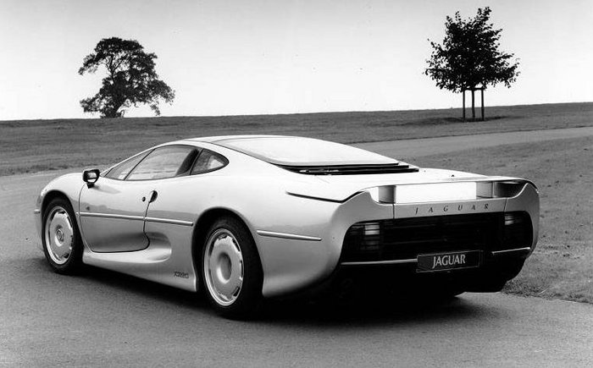
4

Slide 6
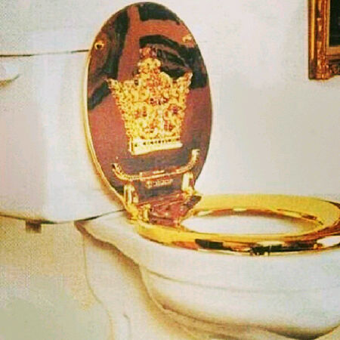
5

Slide 7
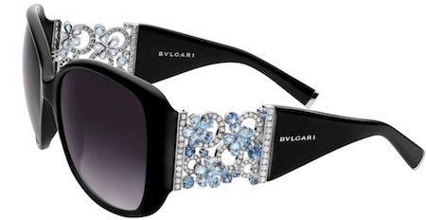
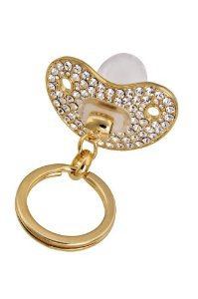
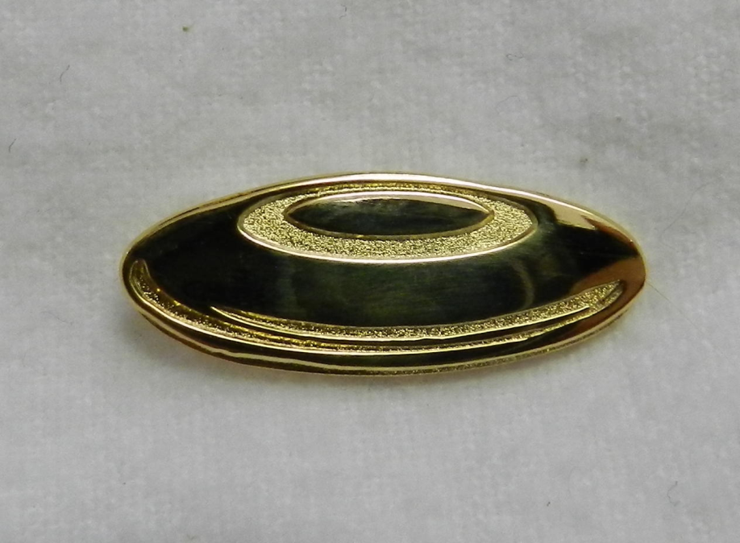
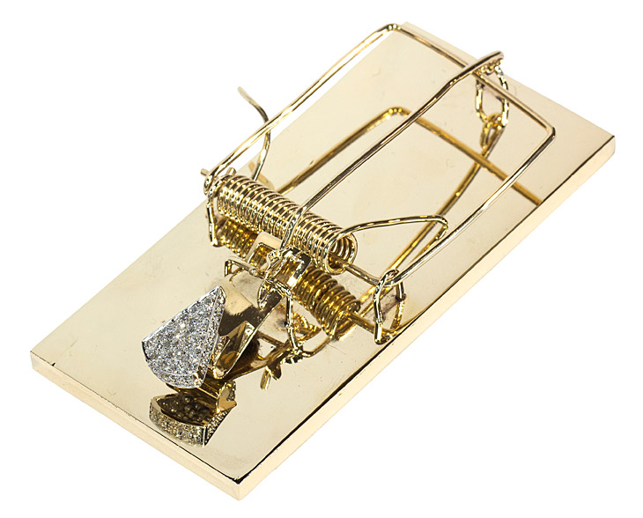
6

Slide 8
The Indescribable Gift
“Thanks be to God for His indescribable gift.” (2 Cor. 9:15)
7

Slide 9
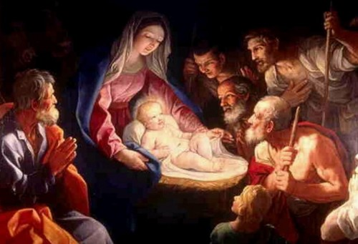
8

Slide 10
The Indescribable Gift
Why is the indescribable gift of Jesus so indescribable?
9

Slide 11
The Indescribable Gift
Why is the indescribable gift of Jesus so indescribable?
A. Because of His nature
10

Slide 12
Max Lucado
“That particular moment was like none other. For through that segment of time a spectacular thing occurred. God became man. While the creatures of earth walked unaware, divinity arrived. Heaven opened herself up and placed her most precious one in a human womb. The omnipotent, in one instant, made Himself breakable. He, who had been a spirit, now was pierce-able. He who was larger than the universe became an embryo…
11

Slide 13
Max Lucado
And He who sustains the world with a word, chose to be dependent upon the nourishment of a young girl. God as a fetus. Holiness sleeping in a womb. The creator of life being created. God was given eyebrows, two kidneys and a spleen. He stretched against the walls and floated in the amniotic fluids of His mother. God had come near.”
12

Slide 14
The Indescribable Gift
Why is the indescribable gift of Jesus so indescribable?
A. Because of His nature
B. Because of the grace
13

Slide 15
Romans 5:8
But God demonstrates his own love for us in this: While we were still sinners, Christ died for us.
14

Slide 16
The Indescribable Gift
Why is the indescribable gift of Jesus so indescribable?
A. Because of His nature
B. Because of the grace
C. Because of its wonderful effect
15

Slide 17
The Indescribable Gift
Why is the indescribable gift of Jesus so indescribable?
A. Because of His nature
B. Because of the grace
C. Because of its wonderful effect
1. Justification
16

Slide 18
The Indescribable Gift
Why is the indescribable gift of Jesus so indescribable?
A. Because of His nature
B. Because of the grace
C. Because of its wonderful effect
1. Justification
2. Reconciliation
17

Slide 19
The Indescribable Gift
Why is the indescribable gift of Jesus so indescribable?
A. Because of His nature
B. Because of the grace
C. Because of its wonderful effect
1. Justification
2. Reconciliation
3. Sanctification
18

Slide 20
The Indescribable Gift
Why is the indescribable gift of Jesus so indescribable?
How does a person receive the indescribable gift of God?
19

Slide 21
The Indescribable Gift
Why is the indescribable gift of Jesus so indescribable?
How does a person receive the indescribable gift of God?
A. Recognize how valuable it is and their need for it
20

Slide 22
The Indescribable Gift
Why is the indescribable gift of Jesus so indescribable?
How does a person receive the indescribable gift of God?
A. Recognize how valuable it is and their need for it
B. The gift cannot be earned or bought
21

Slide 23
Romans 6:23
For the wages of sin is death, but the gift of God is eternal life in Christ Jesus our Lord.
22

Slide 24
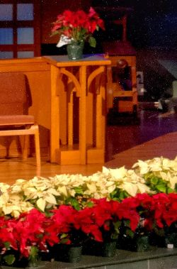
23

Slide 25
The Indescribable Gift
Why is the indescribable gift of Jesus so indescribable?
How does a person receive the indescribable gift of God?
A. Recognize how valuable it is and their need for it
B. The gift cannot be earned or bought
C. The gift must be received
24

Slide 26
John 3:16
For God so loved the world that he gave his one and only Son, that whoever believes in him shall not perish but have everlasting life.
25

Slide 27
Mark 16:16
Jesus said, “Whoever believes and is baptized will be saved.”
26

Slide 28
Acts 2:38, 41
Peter preached, “Repent and be baptized, every one of you, in the name of Jesus Christ so that your sins may be forgiven. And you will receive the gift of the Holy Spirit…Those who accepted his message were baptized and about three thousand were added to their number that day.”
27

Slide 29
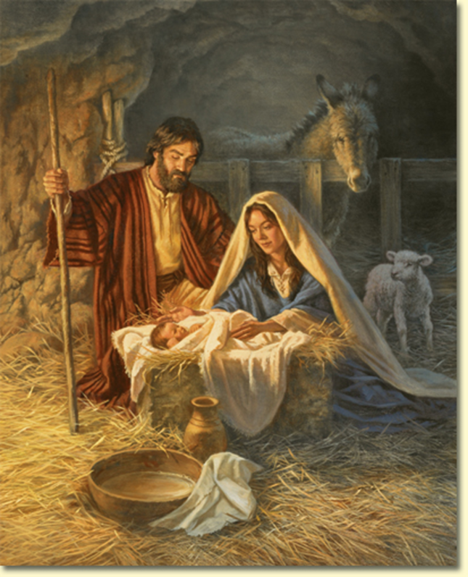

The Indescribable Gift
28

Slide 31


Children’s Message
“The Greatest Gift of All”
1

Slide 32


The Greatest Gift of All
2

