Slide 1
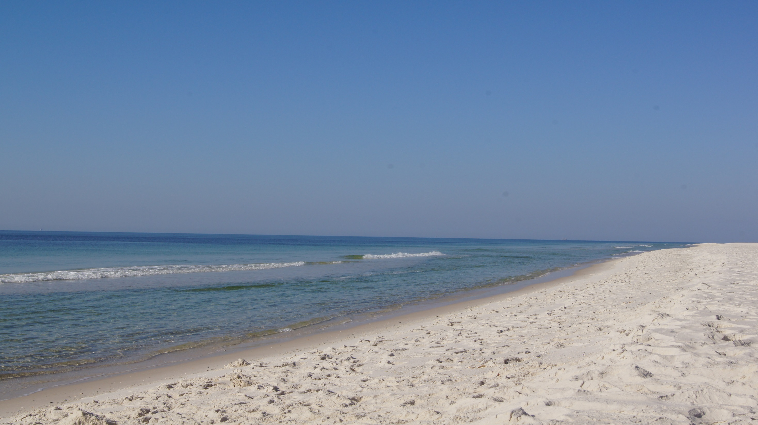
“This is the day that the Lord has made, let us REJOICE and be glad in it!”
Psalm 118:24

Slide 2
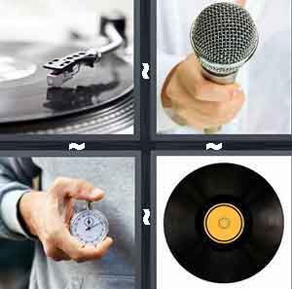
RECORD

Slide 3

Address

Slide 4
RESURRECTION
Hollow Rock
Broken Bread
Piece of Fish

Slide 5
1 Corinthians 15:14, 17, 19…
14 And if Christ has not been raised, then our preaching is in vain and your faith is in vain…17 And if Christ has not been raised, your faith is futile and you are still in your sins…19 If in Christ we have hope in this life only, we are of all people most to be pitied.

Slide 6
Luke 24
Hollow Rock
Broken Bread
Piece of Fish

Slide 7
Luke 24:1-12
Hollow Rock
“An idle tale, and they did not believe them.” (v. 11)
Resurrection was a desperate wish.
All 4 gospels take us to the mouth of the hollow rock…
NOT A DESPERATE WISH…IT’S A REALITY

Slide 8
Luke 24:13-35
BROKEN BREAD
“But we HAD hoped that he was the one to redeem Israel.” (v. 16)
He interpreted to them in all the Scriptures
He took the bread, blessed and broke it, and their eyes were opened
NOT AN ACCIDENT… BUT A CALCULATED PLAN

Slide 9
Luke 24:36-43
Piece of Fish
They said, “IT’S A GHOST!!!”
“See my hands and my feet, that it is I myself.” (v. 39)
"Have you anything here to eat?" (v. 41)
NOT A METAPHOR…
BUT THE REAL DEAL

Slide 10
Our Hope Solidified By…
Hollow Rock
Broken Bread
Piece of Fish

