Slide 1
THESSALONICA
RECEIVING THE WORD IN MUCH AFFLICTION

Slide 2
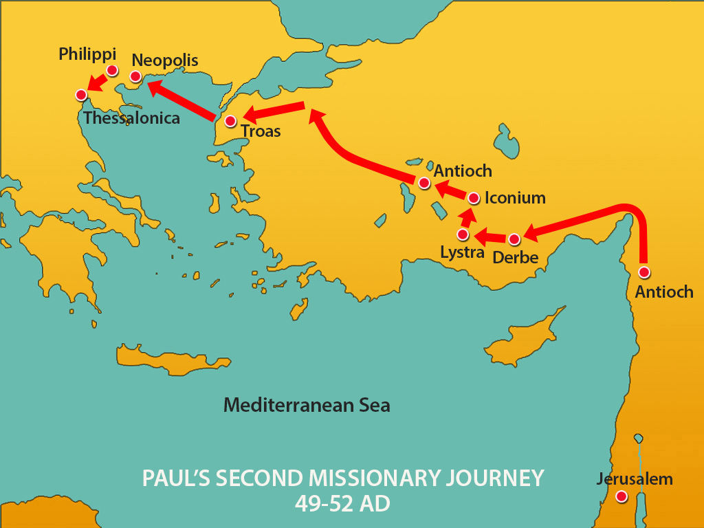

Slide 3
THE CITY
Approx. 100 mi SW of Philippi
Population in Paul’s time estimated at 200,000
Prosperous port city, located on Gulf of Salonika, & also on the Egnatian Way
Established 316 BC by Cassander, one of Alexander’s generals; named it for his wife (also Alex’s ½ sister)
Greatest city of Macedonia, filled with Gentiles & Jews, wealthy b/c of commerce
Modern Greek city of Saloniki occupies the site now

Slide 4
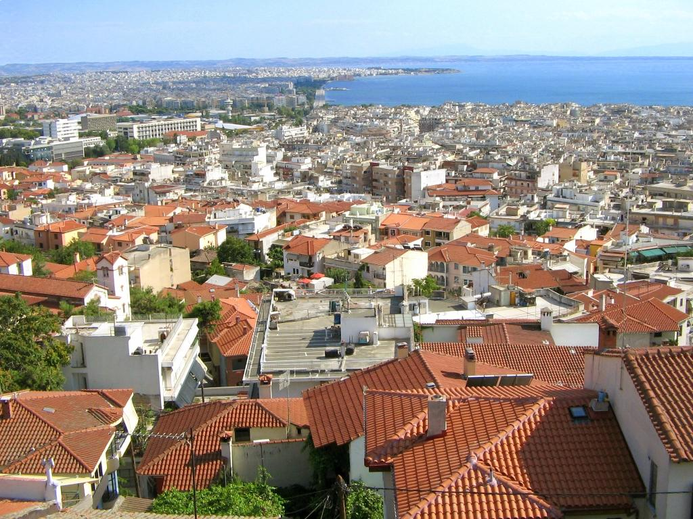

Slide 5
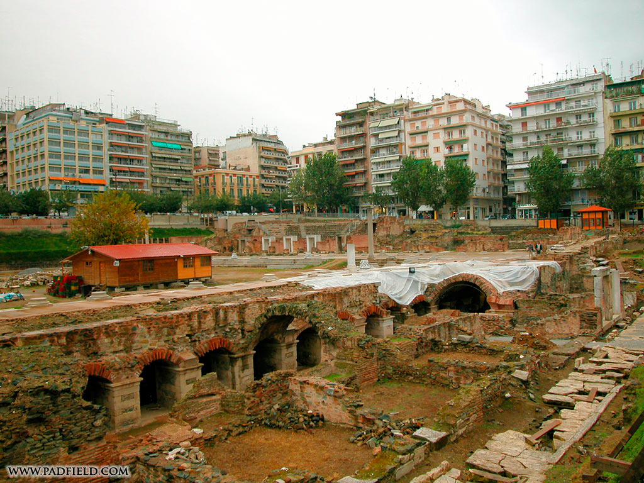

Slide 6
BEGINNING OF THE CHURCH
Paul, Silas, & Timothy went there on 2nd MJ (Acts 17); Paul worked to support himself; also received help from Philippi (twice)
Began by preaching in synagogue (3 Sabbath days)
Many converts, including Jews & Gentiles
Jews became jealous of their success, accused them before city authorities; fled to Berea
Since Paul had to leave quickly, sent Timothy back from Athens to check on the church’s progress, knowing they were facing persecution

Slide 7
1 THESSALONIANS
Paul received a good report from Tim., wrote 1 Thess out of gratitude & joy
Very affectionate & encouraging
Thessalonians were doing well; their faith was well known throughout Macedonia, Achaia, & beyond, in spite of opposition
Church characterized by love for one another
Some problems had arisen & Paul addresses them:
  False assumptions about the 2nd Coming
  Refusal of some to work

Slide 8
2 THESSALONIANS
Written only a few weeks or months after 1st Letter
Persecution continued
Confusion re 2nd Coming had worsened
  Someone had written a bogus letter in Paul’s name
  Claimed the resurrection had passed already!
  Paul says “man of lawlessness” must come first, & he hasn’t - ???
Problem of Christians not working had also gotten worse
  Reason isn’t stated. Maybe connected w. belief re 2nd coming?
  Paul says if they won’t work, don’t let them eat!

Slide 9
LATER DEVELOPMENTS
From Acts & Letters, seems Paul probably visited several times
Aristarchus & Secundus became co-workers with Paul (Acts)
For several centuries, Thess remained a stronghold of Christian faith (later, Greek Orthodoxy)
City attacked several times by various pagan nations; many converted to Christianity
Captured by Sultan Amurath II in 1430, became part of Turkish empire
Recaptured by Greeks in Balkan War of 1912

Slide 10
LESSONS FROM THESSALONICA
Christians can remain strong & faithful, regardless of opposition & persecution.
Faith often develops quickly when under fire.
Even strong churches can have problems, both doctrinal & practical. What’s important is that/how we deal with them.
No matter how strong our faith & love, we can always do better!

