Slide 2
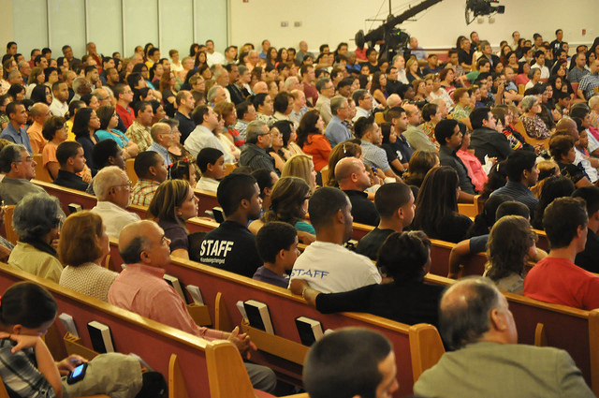
1

Slide 3

Hypocrisy……
2

Slide 4
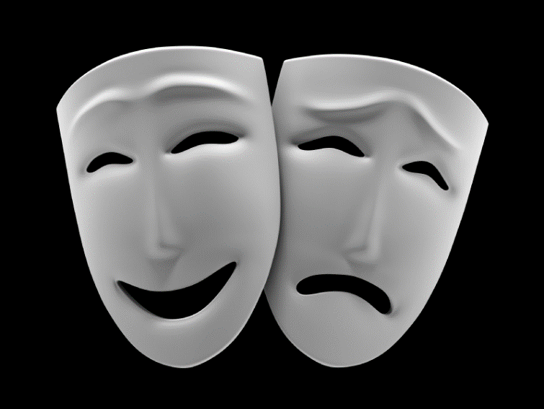
“Hypocrisy is hideous. What cancer is to the body, hypocrisy is to the church. It is a killing agent. Unfortunately, hypocrisy is also addictive. And even though Jesus reserved his most severe words of condemnation for the hypocrite, we still seem to prefer that lifestyle to truth and authenticity.” (John Stott, Sermon on the Mount)…
3

Slide 5

A Healthy Church
4

Slide 6
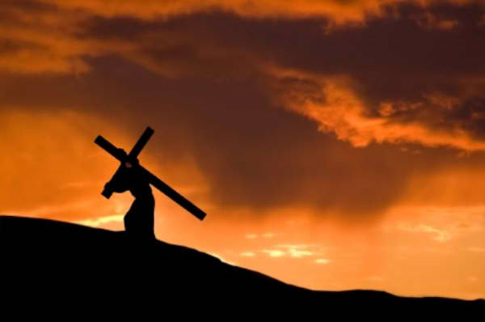
Growing Deeper through Discipleship
“And anyone who does not carry his cross and follow me cannot be my disciple.”
(Lk. 14:27)
5

Slide 7
Growing Deeper through Discipleship
“And anyone who does not carry his cross and follow me cannot be my disciple.”
(Luke 14:27)
“Why do you call me, ‘Lord, Lord’ and do not do what I say?” (Luke 6:46)
6

Slide 8
Growing Deeper through Discipleship
Discipleship calls for…
Control of Temper and Tongue
7

Slide 9
Growing Deeper through Discipleship
Discipleship calls for…
Control of Temper and Tongue
“My dear brothers, take note of this: Everyone should be quick to listen, slow to speak, and slow to become angry, for man’s anger does not bring about the righteous life that God desires.” (James 1:19-20)
8

Slide 10
Growing Deeper through Discipleship
Discipleship calls for…
Control of Temper and Tongue
Moral Purity
9

Slide 11
Growing Deeper through Discipleship
Discipleship calls for…
Control of Temper and Tongue
Moral Purity
“Therefore, get rid of all moral filth and the evil that is so prevalent, and humbly accept the word planted in you, which can save you…Religion that God our Father accepts as pure and faultless is this: to look after orphans and widows in their distress and to keep oneself from being polluted by the world.” (James 1:21, 27)
10

Slide 12
Growing Deeper through Discipleship
Discipleship calls for…
Control of Temper and Tongue
Moral Purity
Obedience to the Word of God
11

Slide 13
Growing Deeper through Discipleship
Discipleship calls for…
Control of Temper and Tongue
Moral Purity
Obedience to the Word of God
“Do not merely listen to the word, and so deceive yourselves. Do what it says... like a man who looks at his face in a mirror…But the man who looks intently into the perfect law…” (James 1:22, 23, 25)
12

Slide 14
Growing Deeper through Discipleship
Discipleship calls for…
Control of Temper and Tongue
Moral Purity
Obedience to the Word of God
Concern for Others
13

Slide 15
Growing Deeper through Discipleship
Discipleship calls for…
Control of Temper and Tongue
Moral Purity
Obedience to the Word of God
Concern for Others
“Religion that God our Father accepts as pure and faultless is this: to look after orphans and widows in their distress…”
(James 1:27)
14

Slide 16
Growing Deeper through Discipleship
What does it mean
to be a disciple of Jesus?
15

Slide 17
Growing Deeper through Discipleship
Discipleship takes
a lot of time and effort!
17

Slide 18
Growing Deeper through Discipleship
Discipleship calls for…
Control of Temper and Tongue
Moral Purity
Obedience to the Word of God
Concern for Others
18

