Slide 2


Slide 3
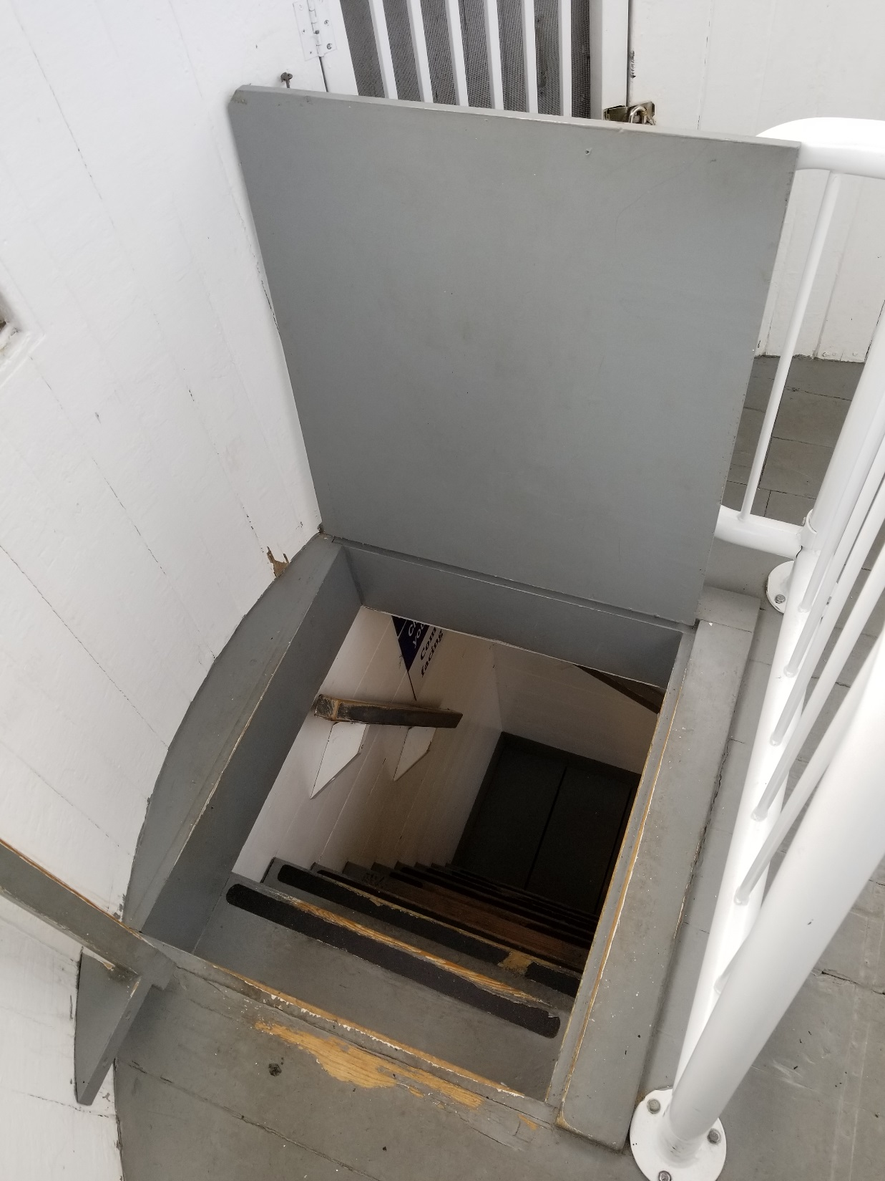

Slide 4
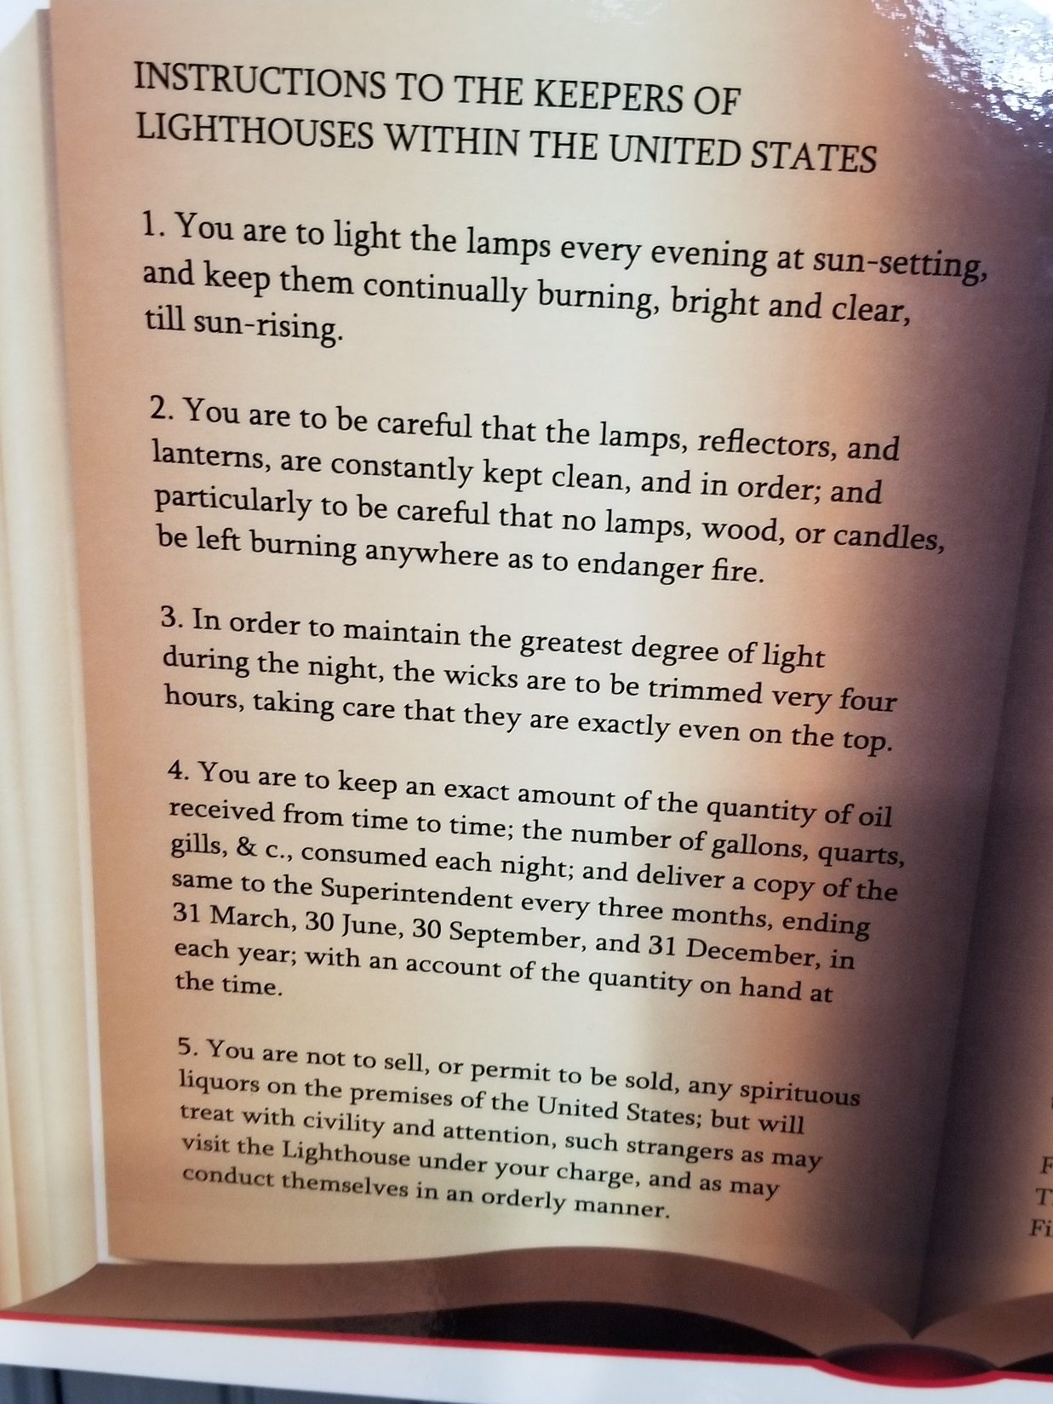
You are to light the lamps every evening at sun-setting, and keep them continually burning, bright and clear, till sun-rising.
Phil. 2:12 – “own salvation”
Gal. 6:7 – “sow and reap”
Rom. 12:1 – “living sacrifice”
Mt. 5:14-16 – “light of world”
Eph. 5:8 – “children of light”

Slide 5
  2. You are to be careful that the lamps, reflectors, and lanterns, are constantly kept clean, and in order; and particularly to be careful that no lamps, wood, or candles, be left burning any where as to endanger fire.
  Eph. 5:15 – “look carefully”
  Heb. 12:15
  2 Cor. 7:1
  1 Pet. 1:7
  1 Tim. 1:19.

Slide 6
  3. In order to maintain the greatest degree of light during the night, the wicks are to be trimmed every four hours, taking care that they are exactly even on the top.
  2 Tim. 1:13 – “follow pattern
  Jude 3 – “faith delivered”
  2 Jn. 9 – “goes onward …”

Slide 7
  4. You are to keep an exact amount of the quantity of oil received from time to time; the number of gallons, quarts, gills, &c., consumed each night; and deliver a copy of the same to the Superintendent every three months, ending 31 March, 30 June, 30 September, and 31 December, in each year; with an account of the quantity on hand at the time.
  Mk. 7:9 (traditions)
  Lk. 11:28 – “hear & keep”
  Jn. 14:15 – love is obedient.
  1 Jn. 5:3 – Commandments are
  not a burden

Slide 8
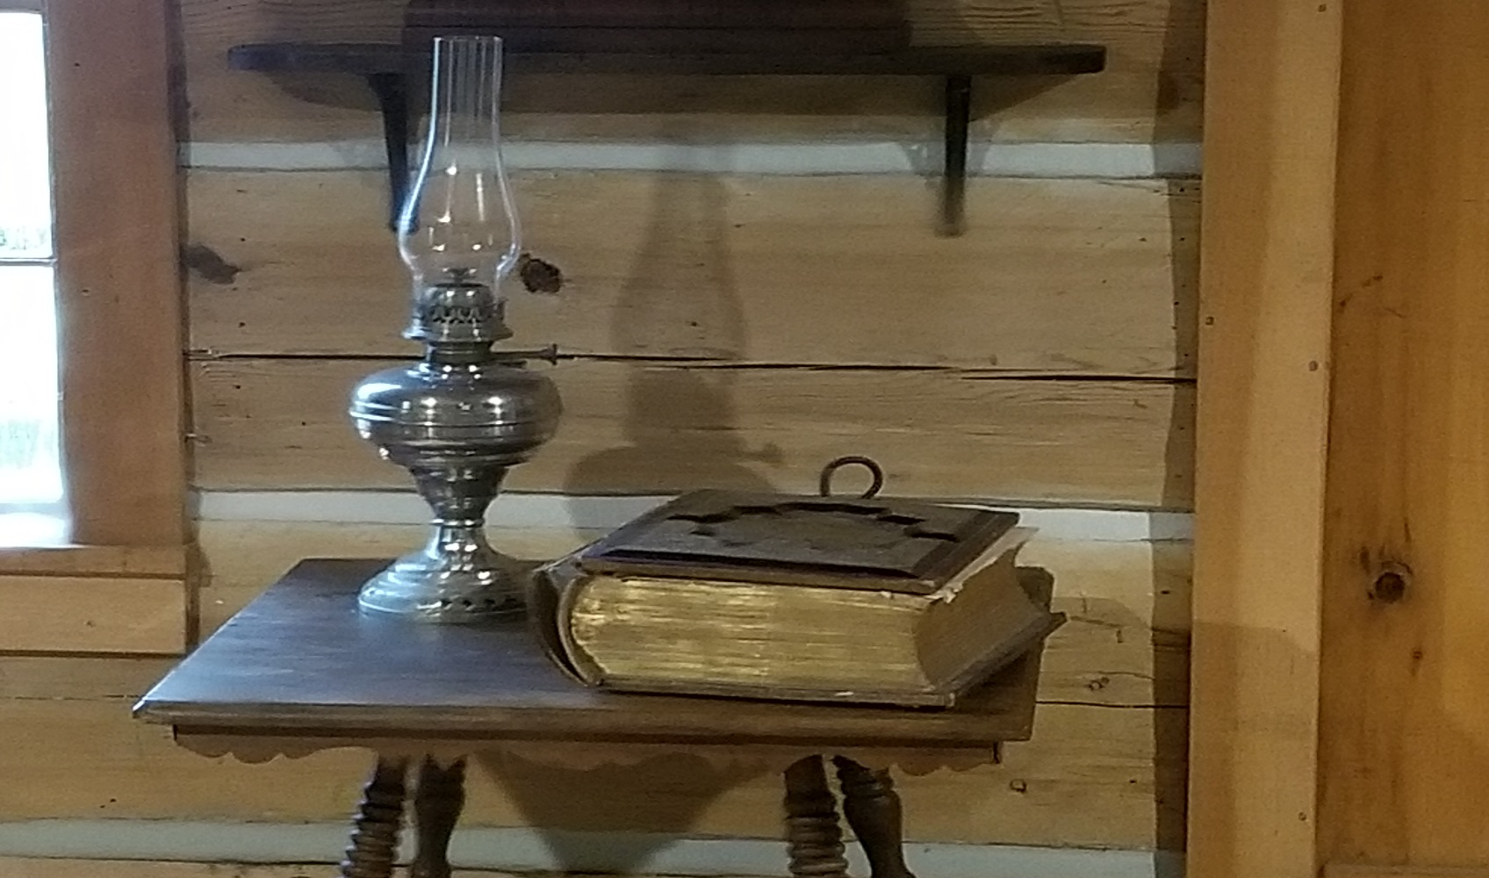
  5. You are not to sell, or permit to be sold, any spirituous liquors on the premises of the United States; but will treat with civility and attention, such strangers as may visit the Light house under your charge, and as may conduct themselves in an orderly manner.

Slide 9
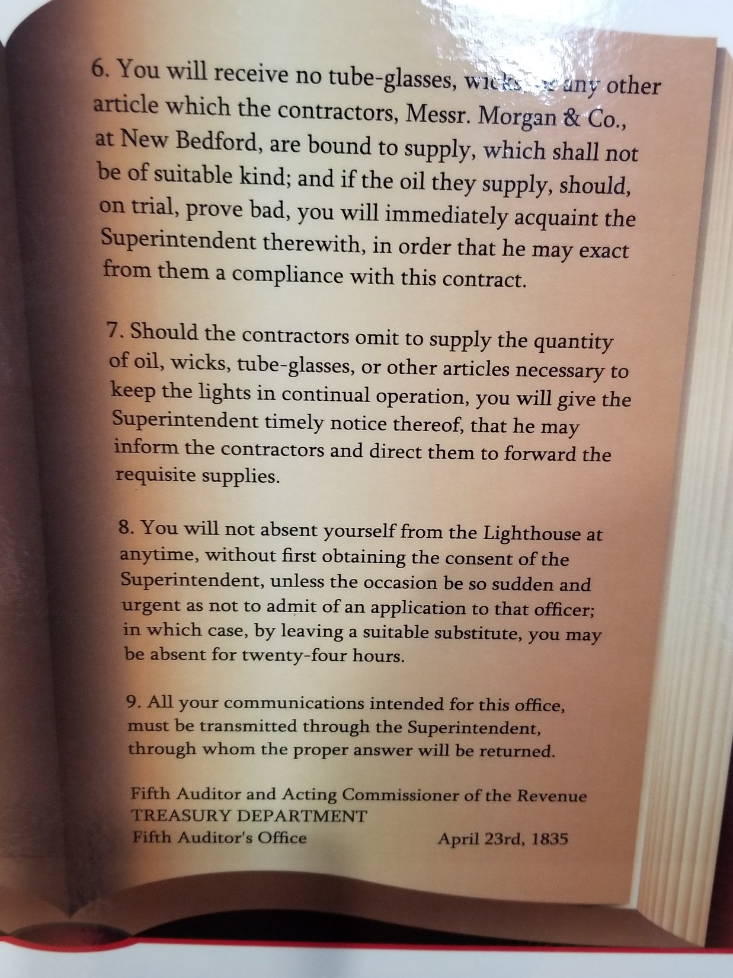
  6. You will receive no tube-glasses, wicks, or any other article which the contractors, Messr. Morgan & Co., at New Bedford, are bound to supply, which shall not be of suitable kind; and if the oil they supply, should, on trial, prove bad, you will immediately acquaint the Superintendent therewith, in order that he may exact from them a compliance with this contract.
    Adam and Eve
    Lot’s wife
    Nadab and Abihu (Lev. 10:1-2)
    King Saul

Slide 10
  7. Should the contractors omit to supply the quantity of oil, wicks, tube-glasses, or other articles necessary to keep the lights in continual operation, you will give the Superintendent timely notice thereof, that he may inform the contractors and direct them to forward the requisite supplies.
  Jas. 4:12
  Rom. 14:13
  Jude 9
  1 Pet. 5:7

Slide 11
  8. You will not absent yourself from the Light-house at any time, without first obtaining the consent of the Superintendent, unless the occasion be so sudden and urgent as not to admit of an application to that officer; in which case, by leaving a suitable substitute, you may be absent for twenty-four hours.
    1 Cor. 15:58
    Heb. 3:14
    Col. 2:7
    Col. 1:23
    Lk. 13:24
    1 Cor. 9:25-26

Slide 12
  9. All your communications intended for this office, must be transmitted through the Superintendent, and through whom the proper answer will be returned.
  1 Tim. 2:5
  Jn. 14:6
  Mt. 6:9
  Eph. 3:14
  Lk. 11:34

