Slide 2
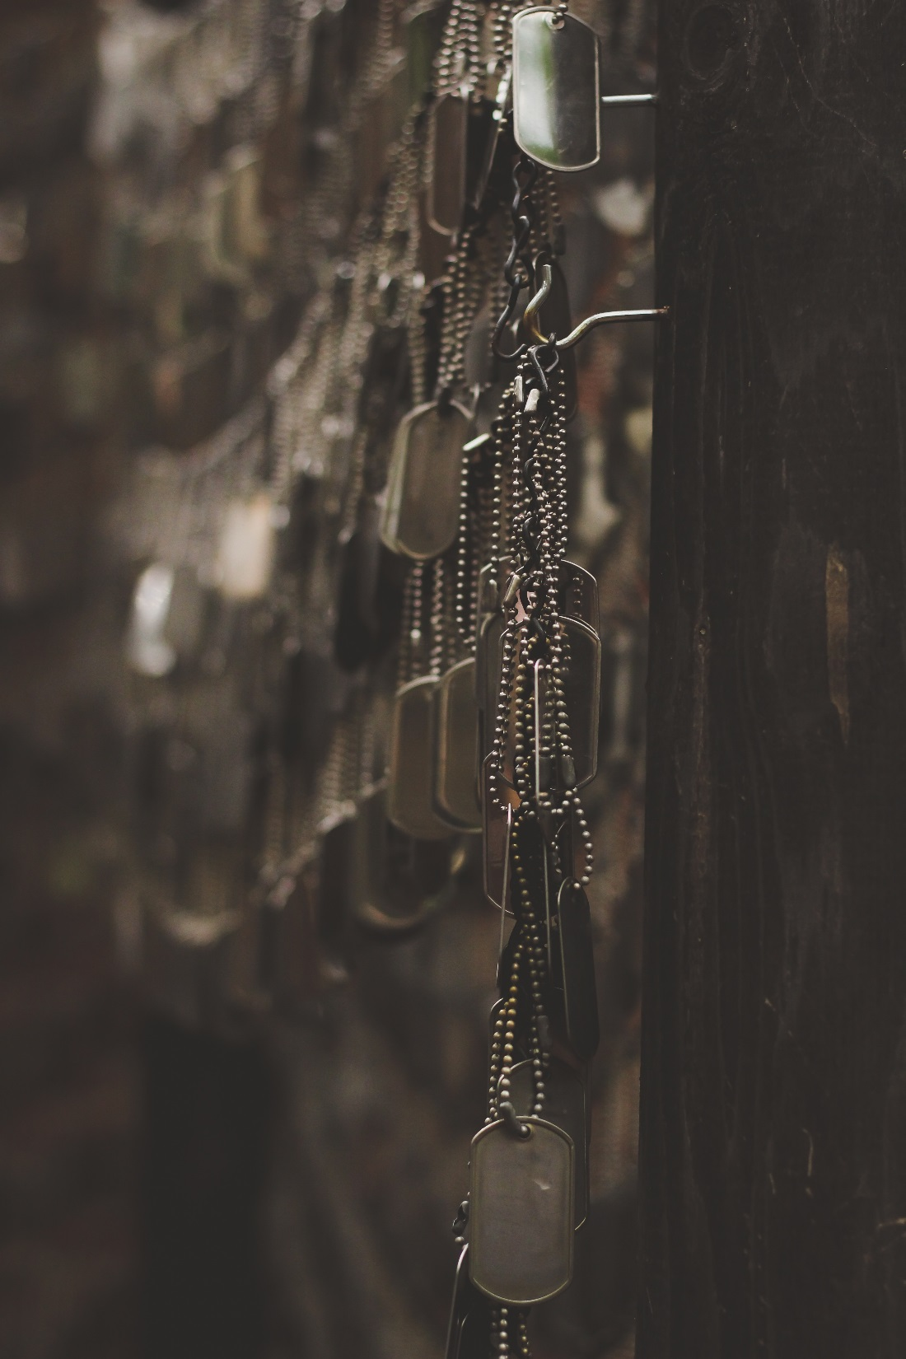
Almost 300 times in Scripture
Ex. 15:3; 1 Sam. 4:8-9
The book of Psalms
1 Sam. 17:36, 45
Lord of Hosts (267 times in OT)
2 Sam. 24; 1 Chron. 21; 1 Sam. 17:47

Slide 3
Amos 9:7
Jer. 1:10
Isa. 13:19
Dan. 4:25
Lk. 2:13
2 Cor. 10:3-5
  “Not war according to flesh”
  No “fleshly weapons”
  The battle is spiritual

Slide 4
Rev. 14:1-5:
And I saw, and behold, the Lamb standing on the mount Zion, and with him a hundred and forty and four thousand, having his name, and the name of his Father, written on their foreheads. 2 And I heard a voice from heaven, as the voice of many waters, and as the voice of a great thunder: and the voice which I heard (was) as (the voice) of harpers harping with their harps: 3 and they sing as it were a new song before the throne, and before the four living creatures and the elders: and no man could learn the song save the hundred and forty and four thousand, (even) they that had been purchased out of the earth. 4 These are they that were not defiled with women; for they are virgins. These (are) they that follow the Lamb whithersoever he goeth. These were purchased from among men, (to be) the firstfruits unto God and unto the Lamb. 5 And in their mouth was found no lie: they are without blemish.
Am I AWOL?

